Slide 1
Kælimeðferð eftir hjartastopp
Martin Ingi Sigurðsson
Morgunfundur 17. september 2021

Slide 2
Tilfelli
66 ára karlmaður, hnígur niður í fótbolta
Endurlífgun hafin innan 5 mín af félögum
Fyrsti taktur vfib, (2x stuð, 3 mg adrenalín)
ROSC eftir 25 mín
Vaknar ekki strax, intuberaður
Inferior ST hækkanir, RCA opnuð í þræðingu
www.socrative.com
Meeting room: MORGUNFUNDUR

Slide 3
Yfirferð yfir fjórar rannsóknir
Allt tímamótarannsóknir í kælimeðferð eftir hjartastopp
Bernhard et al – NEJM 2002
Hypothermia after Cardiac Arrest Study Group – NEJM 2002
TTM trial – NEJM 2015
TTM2 trial – NEJM 2021

Slide 4
Fyrsta rannsóknin

Slide 5
Fyrsta rannsóknin
Inclusion
Utanspítala (Melborne, Ástralía)
VF við komu sjúkrabíls
18 ára og eldri kk, 50 ára og eldri kvk
Exclusion
Cardiogen shock (SBP undir 90 með adrenalíni)
Meðvitundarskerðing talin vegna annars en hjartastopps
Útkoma
Góð neurologísk útkoma (útskrift heim eða endurhæfing)
Slæm neuroloígsk útkoma (lést á sjúkrahúsi eða útskrift á hjúkrunarheimili)

Slide 6
Fyrsta rannsóknin
Inngrip
Ytri kælimeðferð niður í 33 gráður vs 37 gráðu target (með passífri hitun ef þurfti)
Kælt í 12 tíma, passíf hitun uppað 18 tímum svo aktíf hitun uppí 24 tíma
Sæfing með midazolam, vöðvaslökun PN hjá báðum
Lidocaine-dreypi hjá öllum
Oftast lögð niður meðferð ef meðvitundarlausir eftir 72 tíma

Slide 7
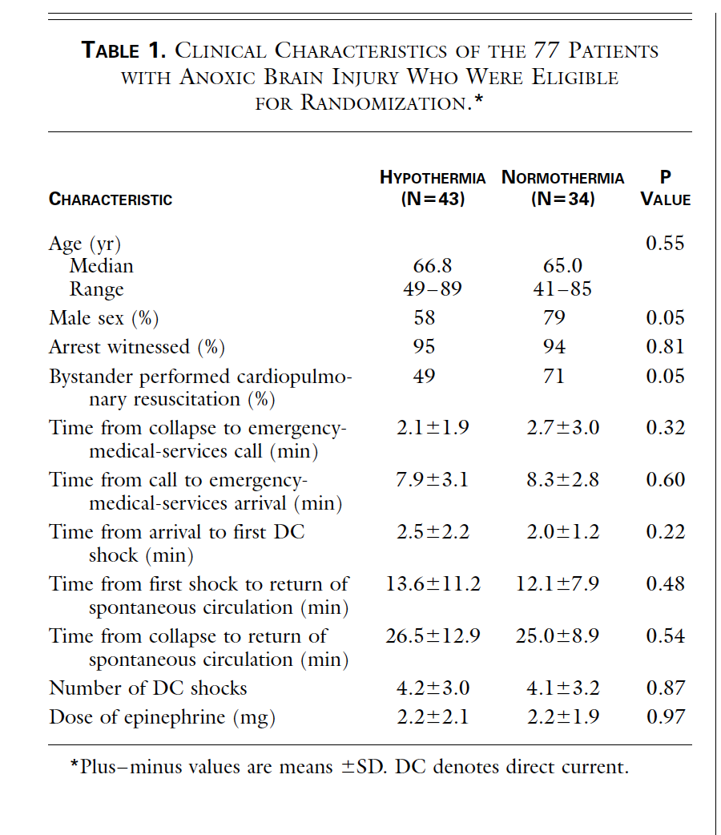
Fyrsta rannsóknin
84 sjúklingar á 33 mánuðum

Slide 8
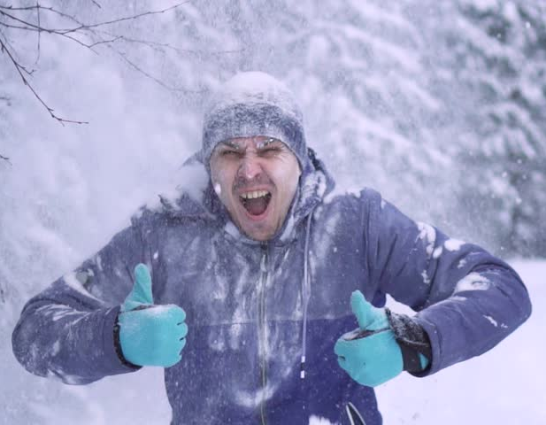
Fyrsta rannsóknin
Útkoma
33 gráður 21/43 (49%) með góða neurologíska útkomu
37 gráður 9/34 (26%) með góða neurologíska útkomu
Langflestir létust eftir að meðferð var lögð niður (2-30 dagur)
Ályktun: Kælimeðferð er góð

Slide 9
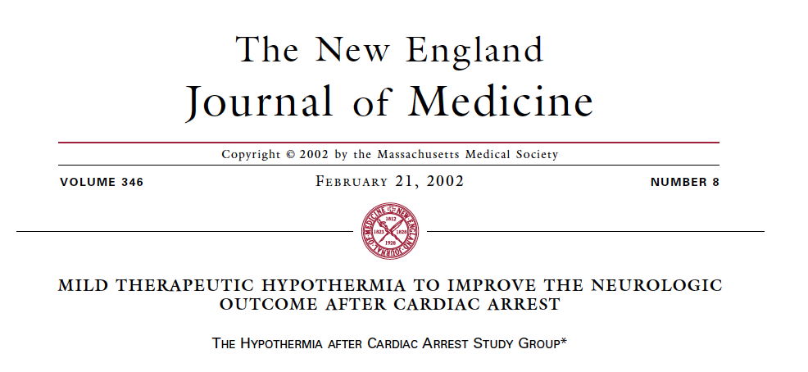
Í sama hefti af NEJM!

Slide 10
Rannsókn 2
Inclusion
Utanspítala (Fjölsetra 9 setur í 5 löndum í Evrópu)
Witnessed arrest, VF/VT fyrsti taktur
Koma sjúkrabíls milli 5 og 15 mín frá collapse
ROSC innan 60 mín við komu sjúkrabíls
18-75 ára
Exclusion
Hiti undir 30 gráðum, meðvitundarleysi fyrir hjartastopp v lyfja, ólétta, terminal sjúkdómur, aðrar rannsóknir í gangi, coagulopatía
Vaknar eftir ROSC
Viðvarandi hypotension eða viðvarandi hypoxia eftir ROSC
Meðvitundarskerðing talin vegna annars en hjartastopps
Útkoma
Góð neurologisk útkoma (Pittsburg cerebral performance cat 1 eða 2 (moderate disability))
Slæm neuroloígsk útkoma (severe disability/vegetative state/death)
Innan 6 mánaða
Secondary ( 6 mán mors og 7 daga complicationir)
Notes:
The primary outcome was a favorable neurologic outcome within
six months, defined as a Pittsburgh cerebral-performance category
of 1 (good recovery) or 2 (moderate disability) on a fivecategory
scale; the other categories were 3 (severe disability), 4 (a
vegetative state), and 5 (death).
21-23
The neurologic outcome was
determined without knowledge of the patient’s treatment assignment.
Patients with good recovery or moderate disability had sufficient
cerebral function to live independently and work at least
part-time.
Secondary end points were overall mortality at six months and
the rate of complications during the first seven days after cardiac
arrest. Bleeding of any severity, pneumonia, sepsis, pancreatitis, renal
failure, pulmonary edema, seizures, arrhythmias, and pressure
sores were recorded. Since an individual patient might have more
than one complication at a time, the occurrence of at least one complication
of any kind per patient was also documented.

Slide 11
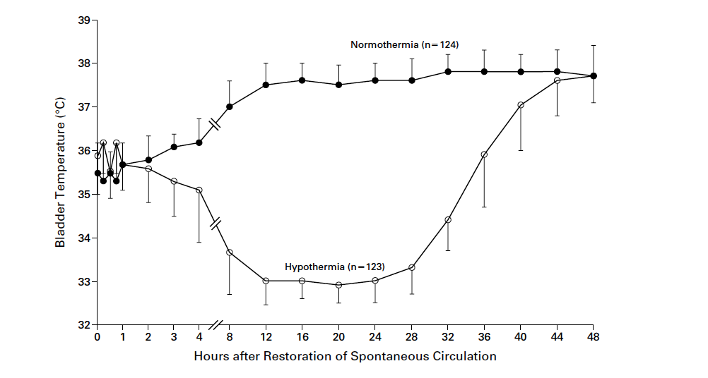
Rannsókn 2
Inngrip
Ytri kælimeðferð niður í 32-34 gráður með kælidýnu/kælilaki vs 37 gráðu target í venjulegu rúmi
Kælt í 24 tíma, hitað upp á næstu 24 tímunum
Svæfing með midazolam og fentanyl, vöðvaslökun PN hjá báðum

Slide 12
Rannsókn 2
275 sjúklingar á 5 árum

Slide 13
Rannsókn 2
275 sjúklingar á 5 árum

Slide 14
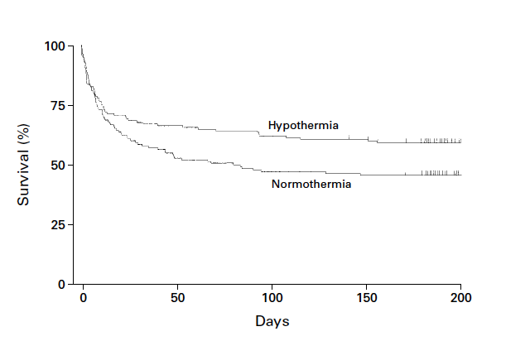
Rannsókn 2
Útkoma
32-34 gráður 75/136 (55%) með góða neurologíska útkomu
37 gráður 54/137 (39%) með góða neurologíska útkomu
6 mánaðar dánartíðni betri fyrir hypothermíu
Lítil breyting þó leiðrétt væri fyrir heilsufari og gangi endurlífgunar
Fylgikvillar sambærilegir
Ályktun: Kælimeðferð er frábær!

Slide 15
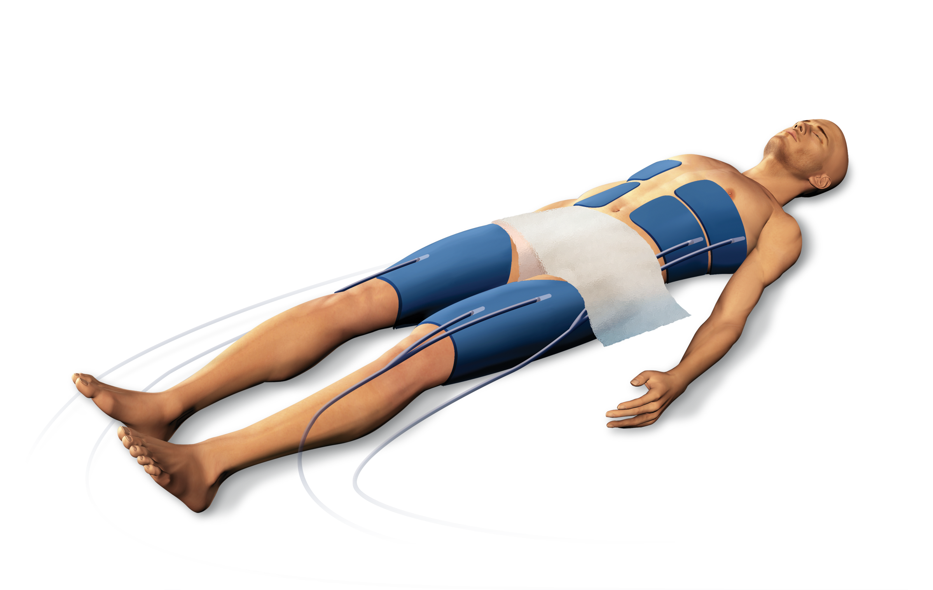
2002 – núna: Hættu að væla - komdu að kæla

Slide 16
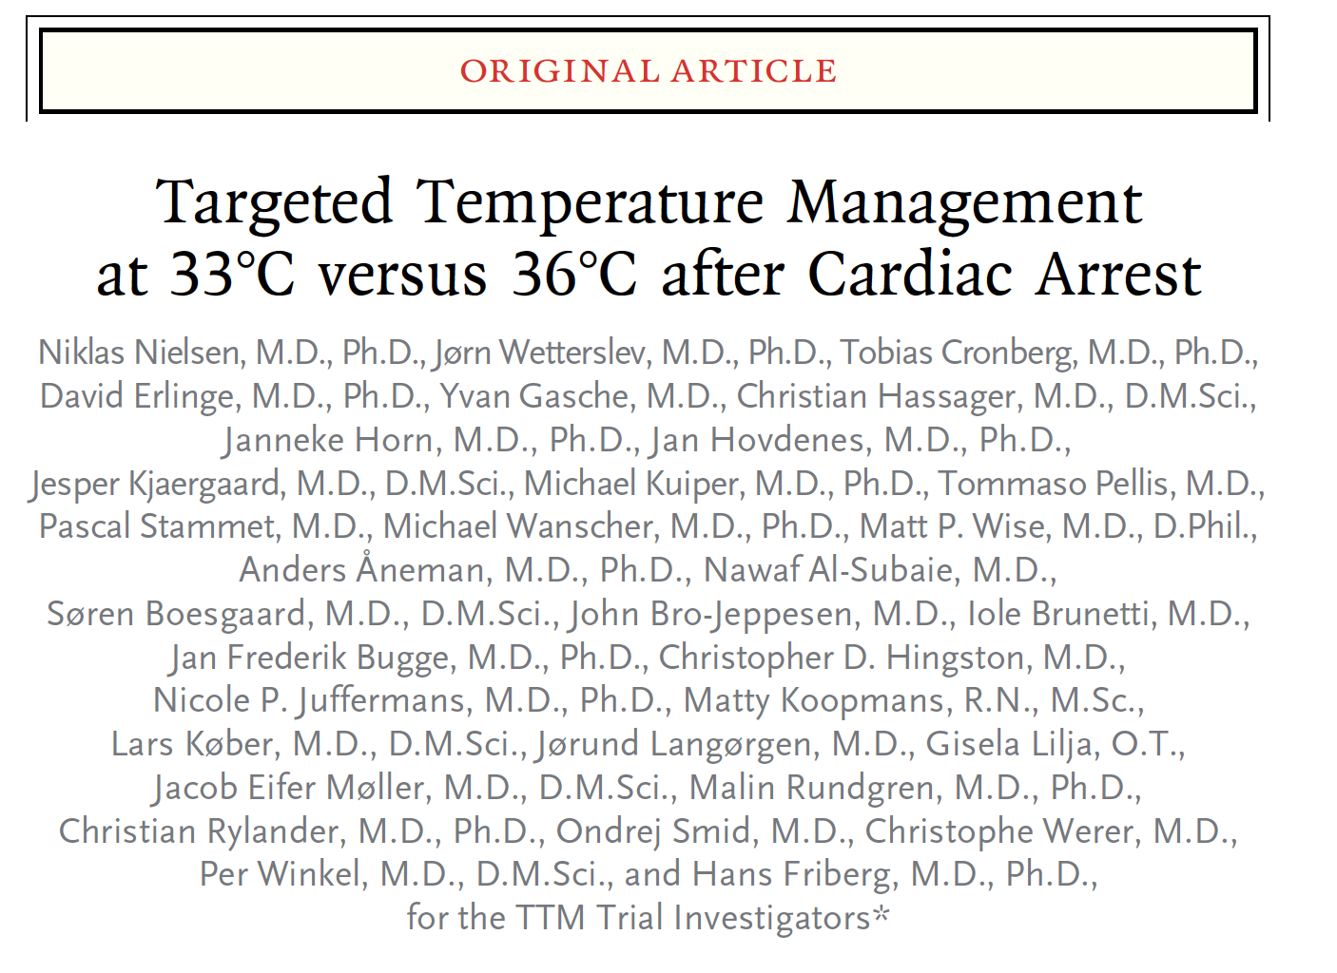
TTM trial – NEJM 2015

Slide 17
Rannsókn 3
Inclusion
Utanspítala (Fjölsetra 36 setur í Evrópu / Ástralíu)
Utanspítalaendurlífgun, óháð fyrsta takti, 20 mín spontant circ eftir ROSC
Exclusion
240 mín frá ROSC til randomiseringar
Unwitnessed og asystola
Grunur um stroke/heilablæðingu
Hiti undir 30 gráður
Útkoma
All cause mortality
Sameinað dauði eða léleg neurologisk útkoma (Cerebral performance category 3-5 eða modified rankin skali 4-6) (almennt moderate neurological disability)
Innan 6 mánaða
Notes:
All surviving patients were followed until 180 days
after the enrollment of the last patient. The primary
outcome was all-cause mortality through the
end of the trial. The main secondary outcome was
a composite of poor neurologic function or death,
defined as a Cerebral Performance Category17,18
(CPC) of 3 to 5 and a score of 4 to 6 on the modified
Rankin scale,19,20 at or around 180 days. The
CPC scale ranges from 1 to 5, with 1 representing
good cerebral performance or minor disability,
2 moderate disability, 3 severe disability, 4 coma
or vegetative state, and 5 brain death. Scores on
the modified Rankin scale range from 0 to 6,
with 0 representing no symptoms, 1 no clinically
significant disability, 2 slight disability, 3 moderate
disability, 4 moderately severe disability, 5 severe
disability, and 6 death. Mortality at 180 days and
individual neurologic scores were also analyzed
separately. Other secondary outcomes were the
CPC at discharge from the ICU and from the hospital
and the best (numerically lowest) reported
CPC during the trial period. Predefined serious
adverse events21 were recorded up to day 7 in the
ICU. Data collection and verification for all trial
data and for the outcome measures are described
in the Supplementary Appendix.
Statistical Analysis
We estimated that a sample of 900 patients would
provide 90% power to detect a 20% reduction in
the hazard ratio for death in the 33°C group as
compared with the 36°C group, at a two-sided
alpha level of 0.05. Alternatively, to detect a relative
risk reduction of 20%, with the assumption
of a mortality of 44% in the 33°C group versus
55% in the 36°C group, a sample of 850 patients
would be needed. On the basis of these assumptions,
a sample of 950 patients was chosen, to
allow for a loss to follow-up of 50 patients.
The principal trial analyses were performed
in the modified intention-to-treat population,
defined as all randomly assigned patients except
those withdrawing consent for use of all trial
data and those not fulfilling inclusion criteria
and never receiving the intervention.22 Additional
analyses were performed in the intention-to-treat
population, which included all randomly assigned
patients except those withdrawing consent, and
in the per-protocol population, which excluded
patients with one or more major protocol violations
(listed in the Supplementary Appendix).

Slide 18
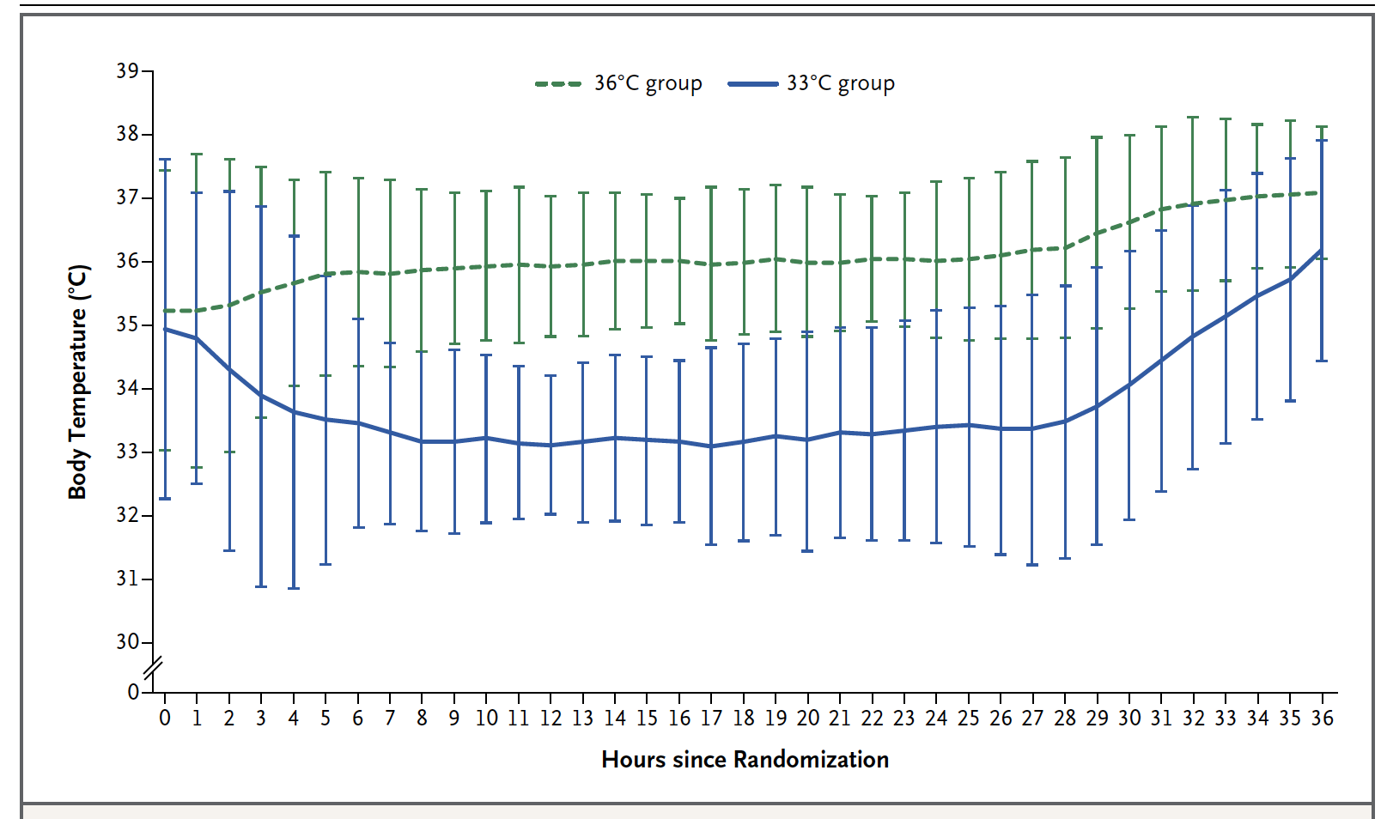
Rannsókn 3
Inngrip
Ytri kælimeðferð niður í 33 gráður vs 36 gráður intravascular vs ytri kæling
36 klst svæfing, ótiltekin lyf
Eftir 28 klst, hitað uppí 37 gráður
Reynt að halda hita undir 37,5 allt að 72 klst eftir hjartastopp

Slide 19
Rannsókn 3
950 sjúklingar á 3 árum

Slide 20
Rannsókn 3
950 sjúklingar á 3 árum

Slide 21
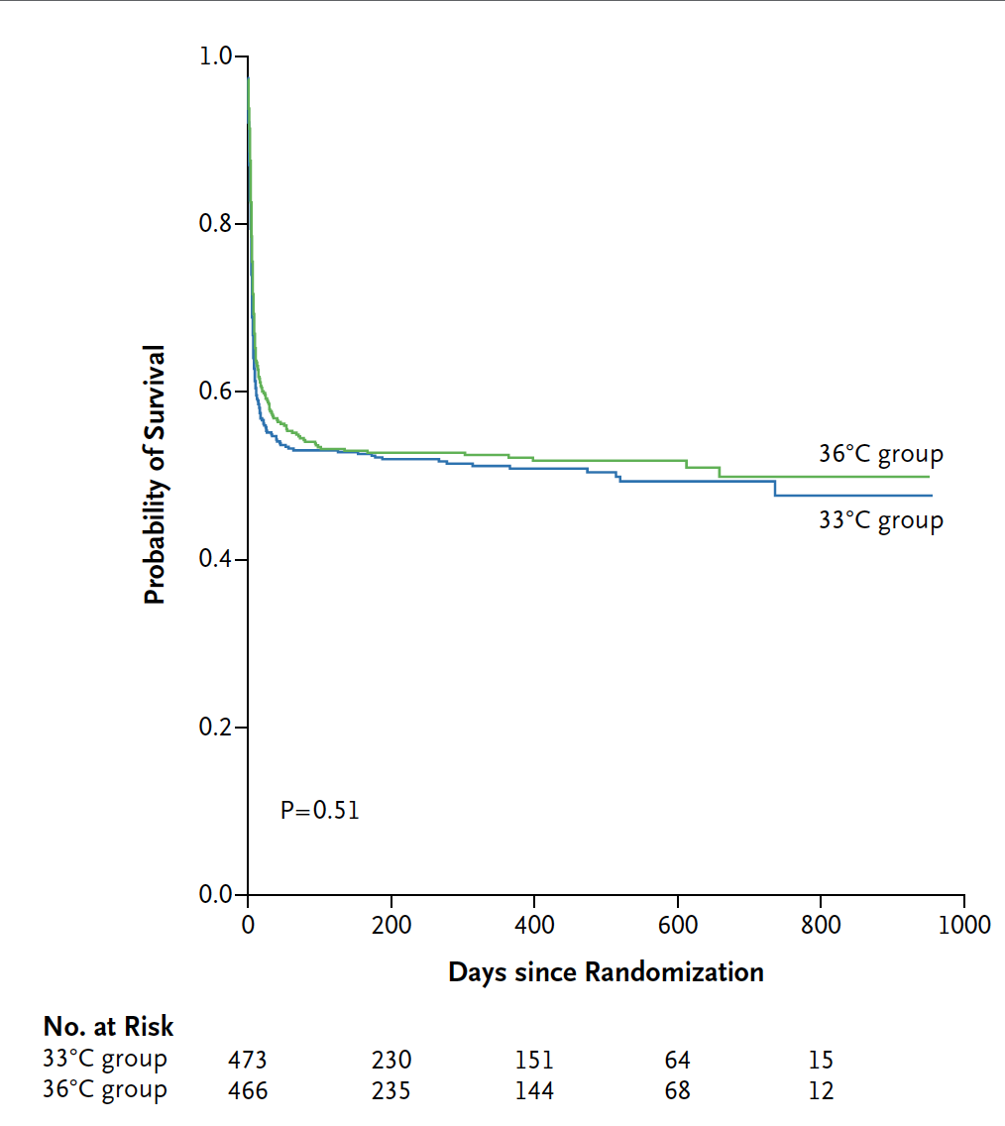
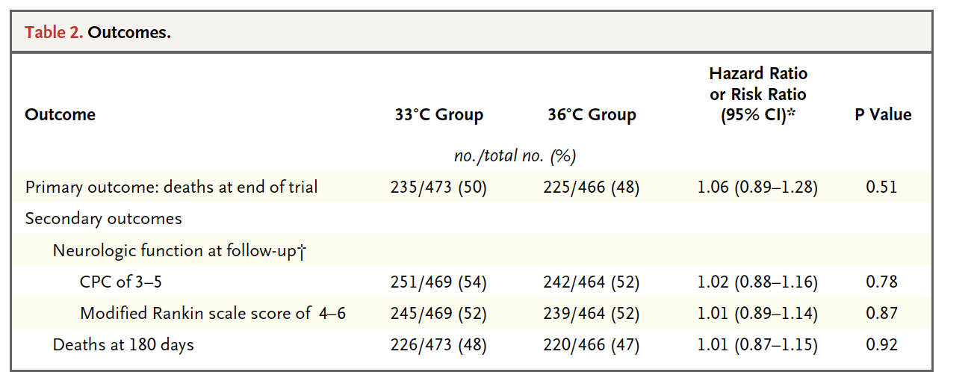
Rannsókn 3
Kæling virðist ekki betri
En enginn varð hyperthermískur
Og allir voru áfram svæfðir

Slide 22
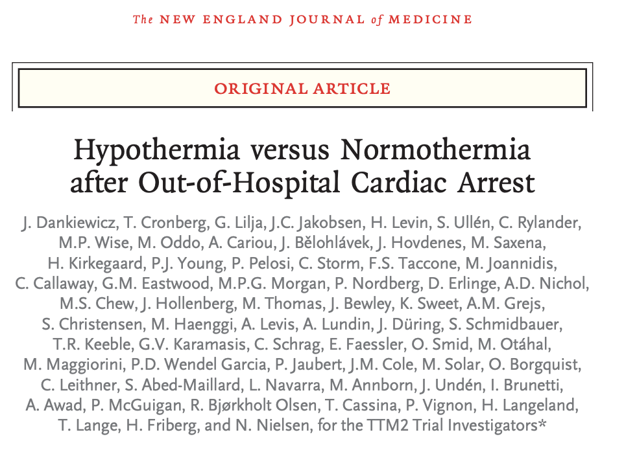
TTM2 – NEJM 2021

Slide 23
Rannsókn 4
Inclusion
Utanspítalaendurlífgun, óháð fyrsta takti, 20 mín spontant circ eftir ROSC
Exclusion
180 mín frá ROSC til randomiseringar
Unwitnessed og asystola
Meðferðartakmarkanir
Útkoma
All cause mortality
Modified rankin skali 4-6) (almennt moderate neurological disability)
Innan 6 mánaða
Notes:
All surviving patients were followed until 180 days
after the enrollment of the last patient. The primary
outcome was all-cause mortality through the
end of the trial. The main secondary outcome was
a composite of poor neurologic function or death,
defined as a Cerebral Performance Category17,18
(CPC) of 3 to 5 and a score of 4 to 6 on the modified
Rankin scale,19,20 at or around 180 days. The
CPC scale ranges from 1 to 5, with 1 representing
good cerebral performance or minor disability,
2 moderate disability, 3 severe disability, 4 coma
or vegetative state, and 5 brain death. Scores on
the modified Rankin scale range from 0 to 6,
with 0 representing no symptoms, 1 no clinically
significant disability, 2 slight disability, 3 moderate
disability, 4 moderately severe disability, 5 severe
disability, and 6 death. Mortality at 180 days and
individual neurologic scores were also analyzed
separately. Other secondary outcomes were the
CPC at discharge from the ICU and from the hospital
and the best (numerically lowest) reported
CPC during the trial period. Predefined serious
adverse events21 were recorded up to day 7 in the
ICU. Data collection and verification for all trial
data and for the outcome measures are described
in the Supplementary Appendix.
Statistical Analysis
We estimated that a sample of 900 patients would
provide 90% power to detect a 20% reduction in
the hazard ratio for death in the 33°C group as
compared with the 36°C group, at a two-sided
alpha level of 0.05. Alternatively, to detect a relative
risk reduction of 20%, with the assumption
of a mortality of 44% in the 33°C group versus
55% in the 36°C group, a sample of 850 patients
would be needed. On the basis of these assumptions,
a sample of 950 patients was chosen, to
allow for a loss to follow-up of 50 patients.
The principal trial analyses were performed
in the modified intention-to-treat population,
defined as all randomly assigned patients except
those withdrawing consent for use of all trial
data and those not fulfilling inclusion criteria
and never receiving the intervention.22 Additional
analyses were performed in the intention-to-treat
population, which included all randomly assigned
patients except those withdrawing consent, and
in the per-protocol population, which excluded
patients with one or more major protocol violations
(listed in the Supplementary Appendix).

Slide 24
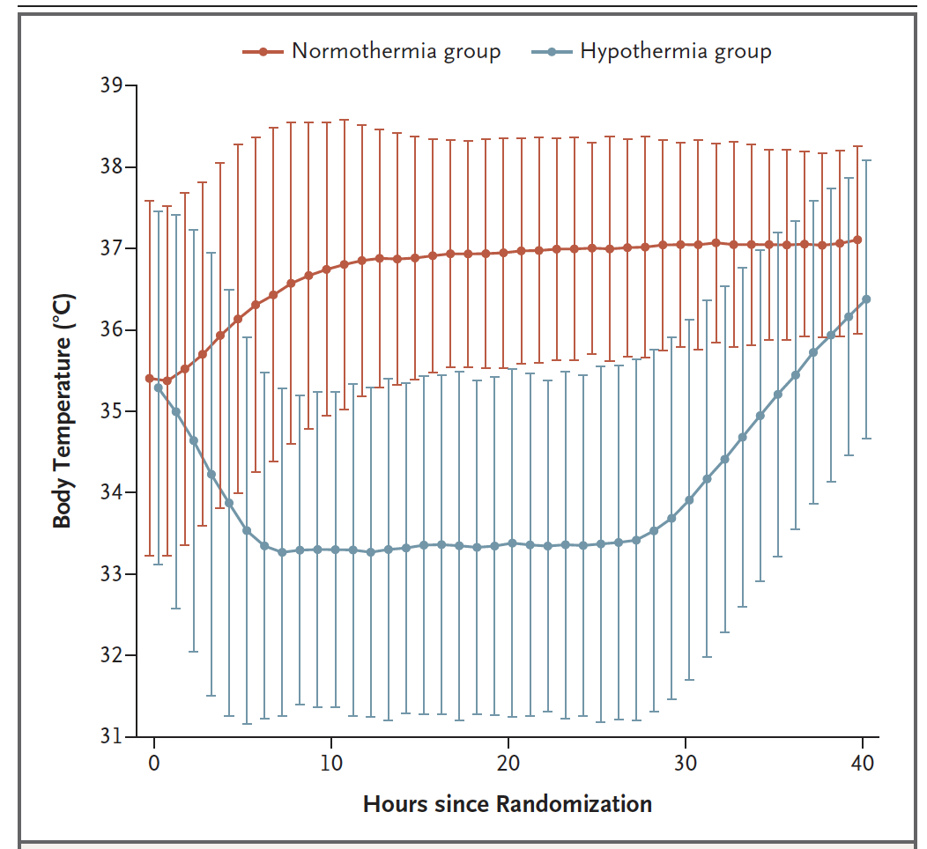
Rannsókn 4
Inngrip
Ytri/innri kælimeðferð niður í 33 gráður ivs target 37,5 eða minna (kæling af stað ef hiti yfir 37,8)
Eftir 28 klst, hitað uppí 37 gráður
Reynt að halda hita undir 37,7 allt að 72 klst eftir hjartastopp
ATH - 46% af “normothermiu” fékk kæli-device
70% yfirborðs, 30% intravascular

Slide 25
Rannsókn 4
1850 sjúklingar á 3 árum

Slide 26
Rannsókn 4
1850 sjúklingar á 3 árum

Slide 27
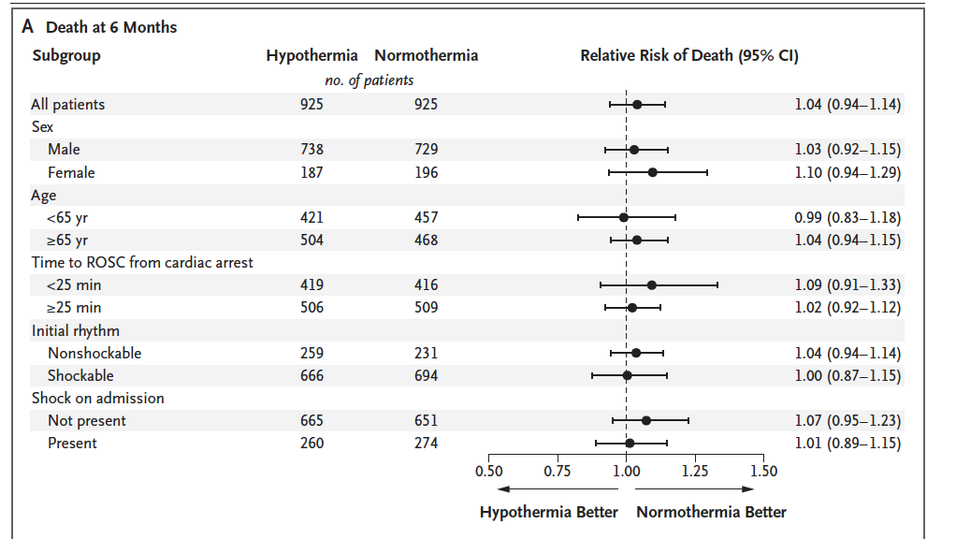
Rannsókn 4

Slide 28
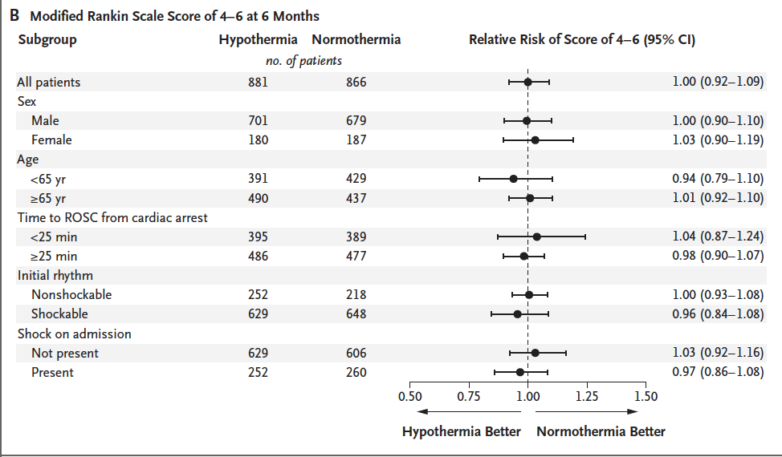
Rannsókn 4

Slide 29
TTM2 - umræður
Í samræmi við TTM1
Sameinað við TTM1 (900+1800 sjúklingar):
trials imply a low likelihood of any meaningful clinical improvement with hypothermia as compared with normothermia, since 36°C may be considered to be the lower boundary of normothermia
En
Hitastýring var notuð hjá 46% af control hópnum
Allir fengu 40 klst sedation

Slide 30
Afhverju er þetta alltaf að breytast!
Notes:
Bystander performed CPR úr 40-50% í yfir 70%

Slide 31
Afhverju er þetta alltaf að breytast!
Lifun er almennt að batna
Viðmiðunarhópurinn úr 30% lifun í 50% lifun
Einn möguleiki: bystander performed PCR
Fyrstu tvær : 40-50%
TTM1 - 70%
TTM2 - 80%
Hypothermia er orðin standard of care
Engin virk hitun hjá neinum
Agressíf meðferð á hyperthermíu hjá öllum í control hópum TTM1 og 2
Notes:
Bystander performed CPR úr 40-50% í yfir 70%

Slide 32
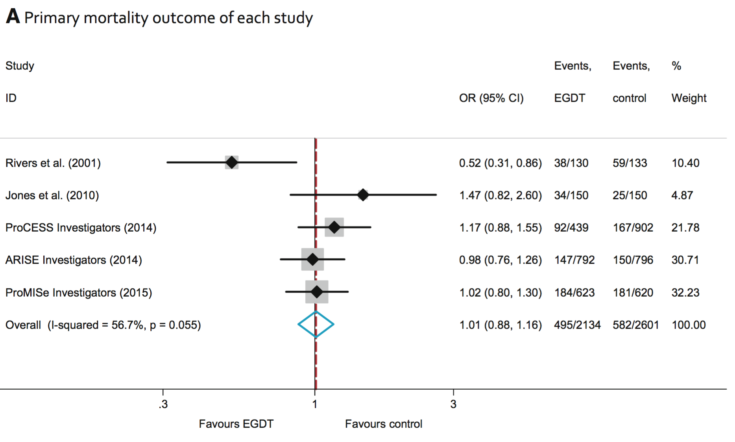
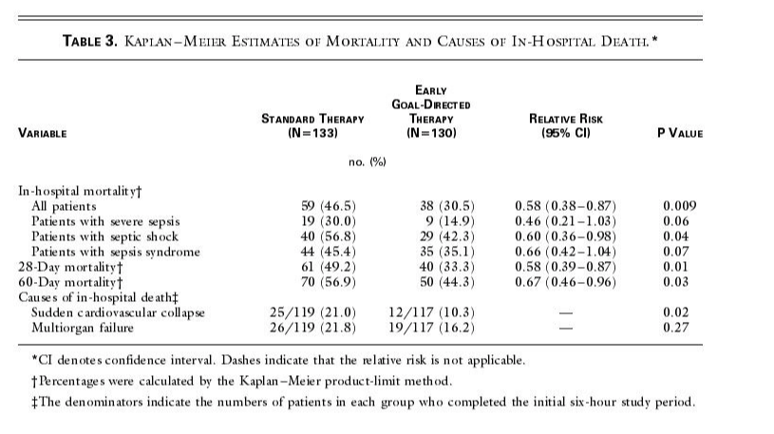
Önnur dæmi um breytingar

Slide 33
Hvað eigum við að gera?
Kæla vs hitastýra?
Invasíf hitastýring vs ytri hitastýring?
Svæfa / ekki svæfa?

Slide 34
Tilfelli
66 ára karlmaður, hnígur niður í fótbolta
Endurlífgun hafin innan 5 mín af félögum
Fyrsti taktur vfib, (2x stuð, 3 mg adrenalín)
ROSC eftir 20 mín
Vaknar ekki
Inferior ST hækkanir, RCA opnuð í þræðingu
www.socrative.com
Meeting room: MORGUNFUNDUR

Slide 35
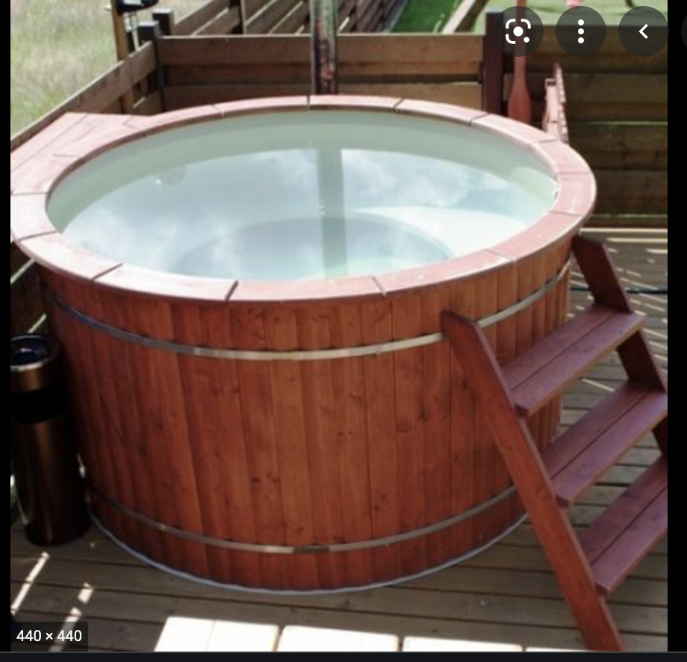
Umræður!

Slide 36
Hvað finnst mér
Svæfa – já
Hitastýring – já
Ytri hitastýring?
Hitastig
36°

